Slide 1
Analyzing largest Solar Power Plants globally
Nitheeshwaran . R
Pragadeeswaran . Ra
.

Slide 2
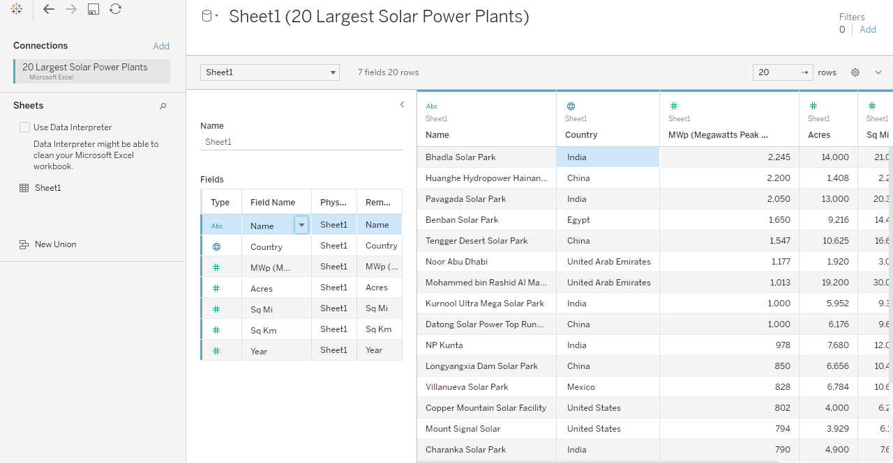
Tableau Start page

Slide 3
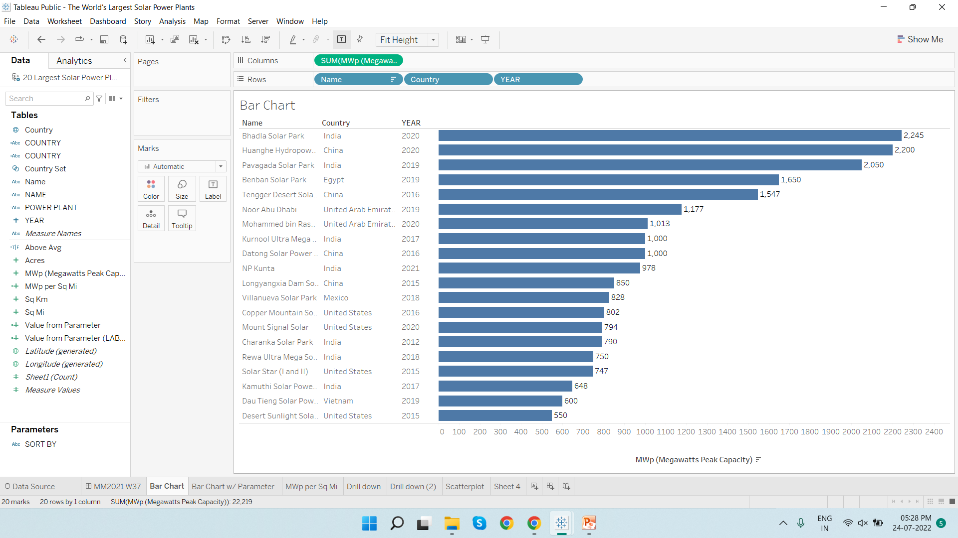
Which produces highest MWp?
By dragging down required parameters; obtained the highest Megawatts peak capacity(MWp) produced by Solar Powerplants.

Slide 4
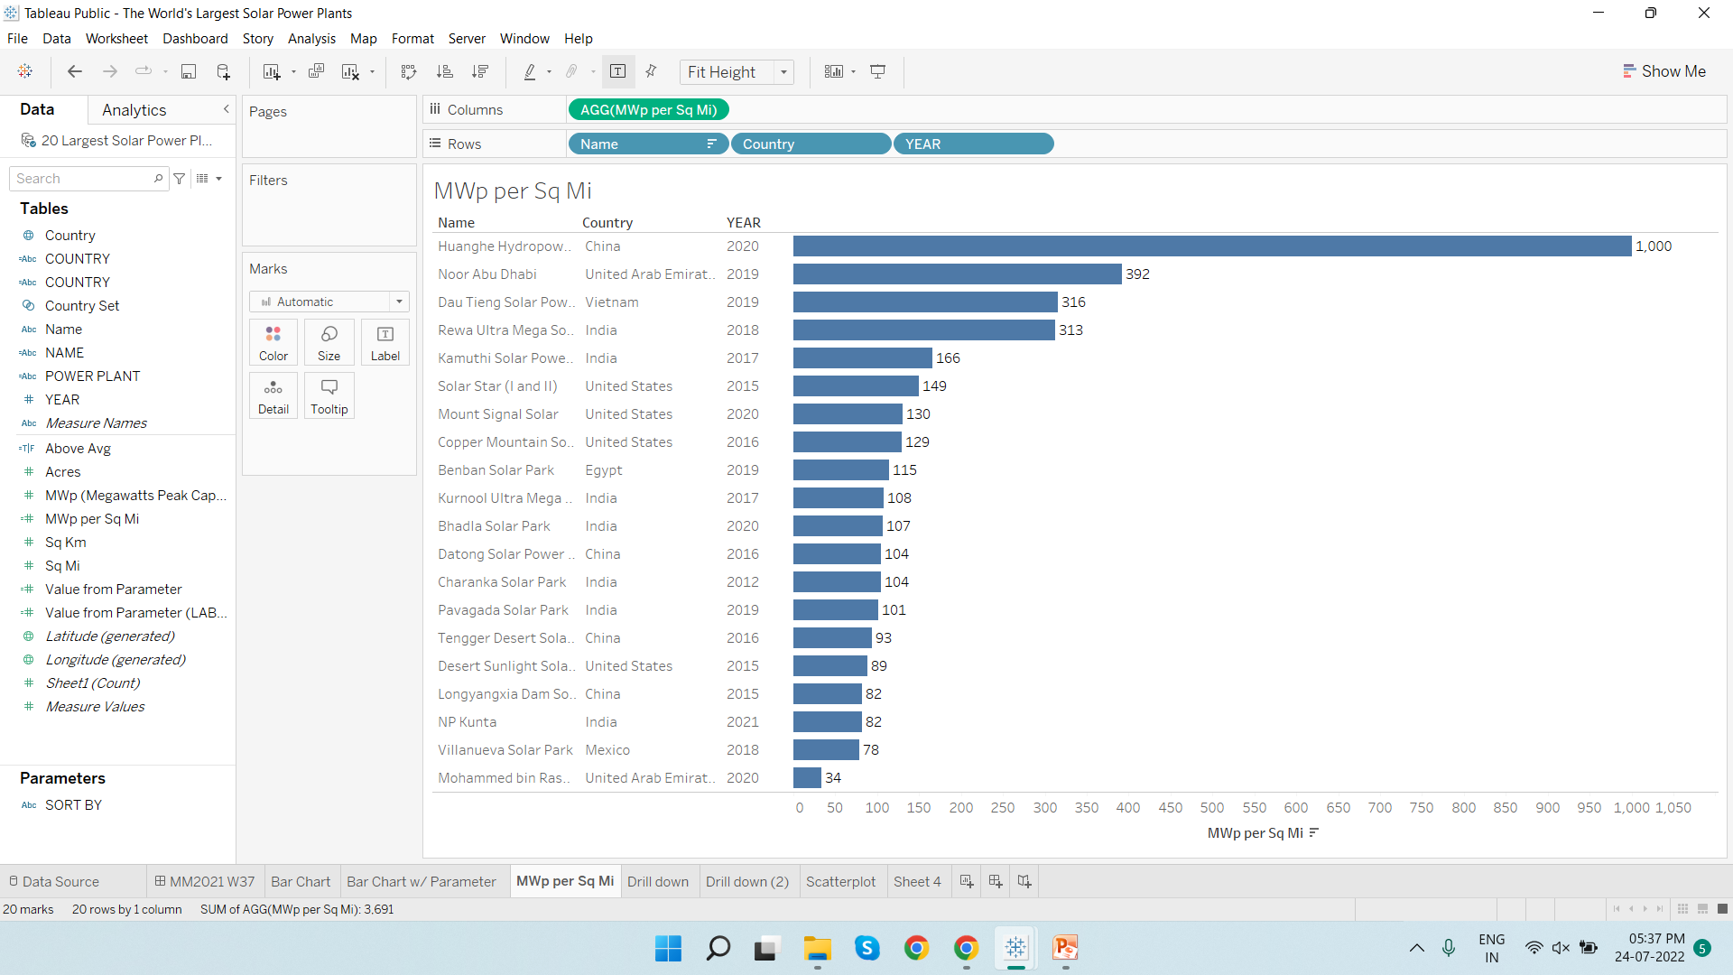
MWp per Square miles
Create a calculated field for MWp per square miles by using SUM([MWp (Megawatts Peak Capacity)]) / SUM([Sq. Mi])

Slide 5
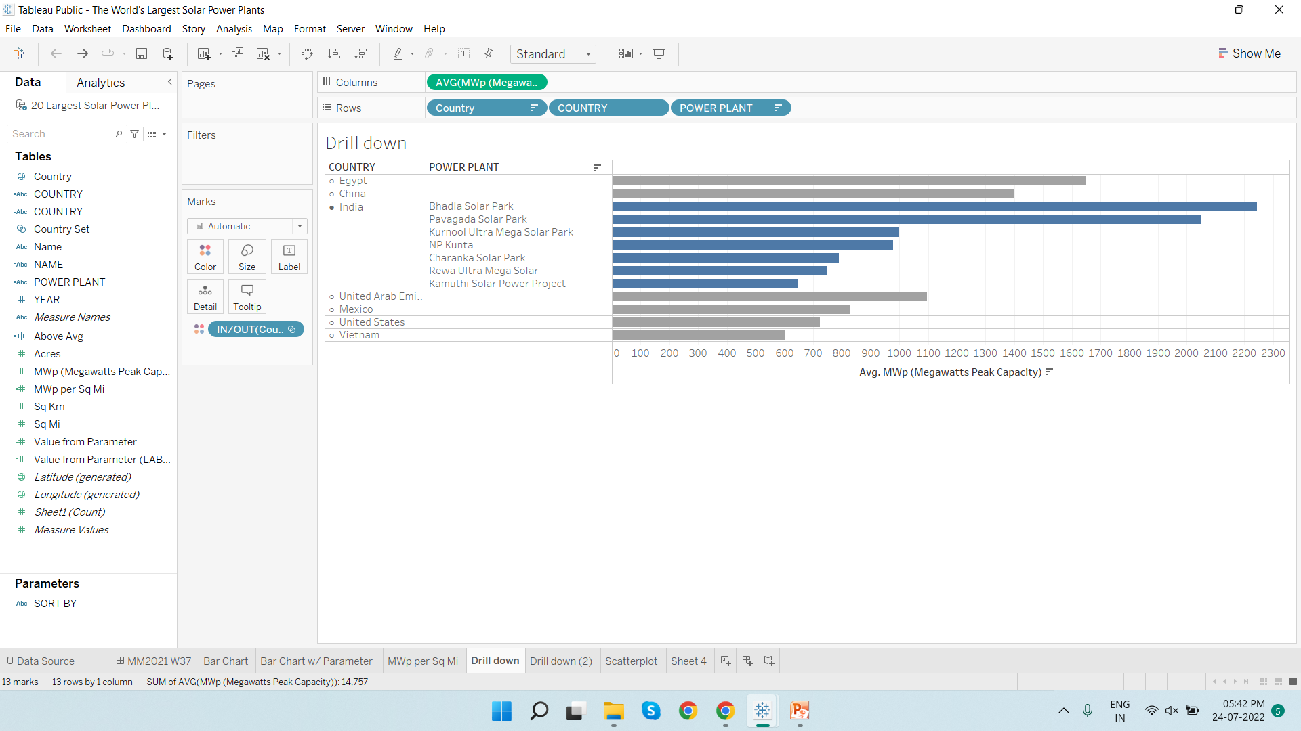
Drill down (Average values)

Slide 6
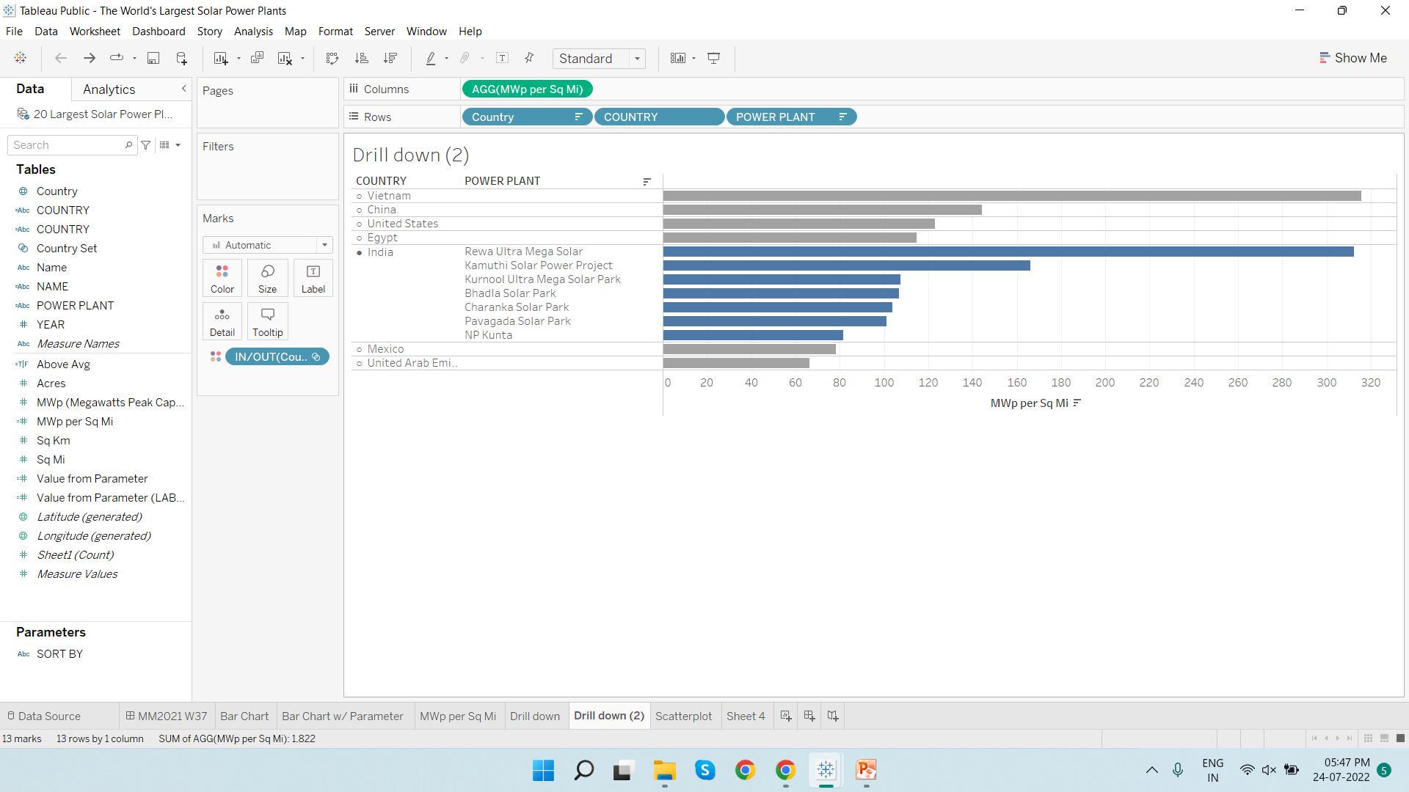
Drill down (Aggregated Values)

Slide 7
Scatterplot

Slide 8
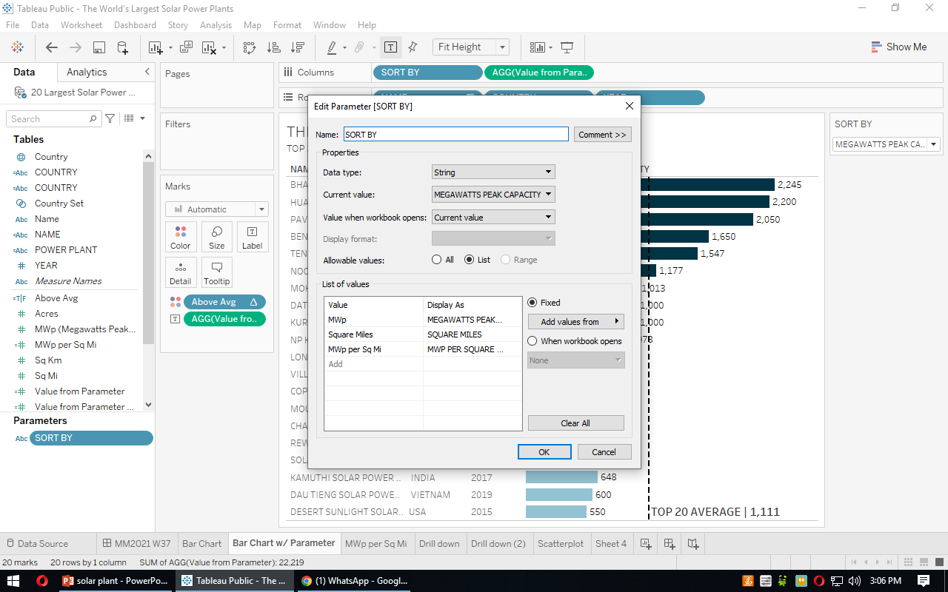
Creating Parameters

Slide 9
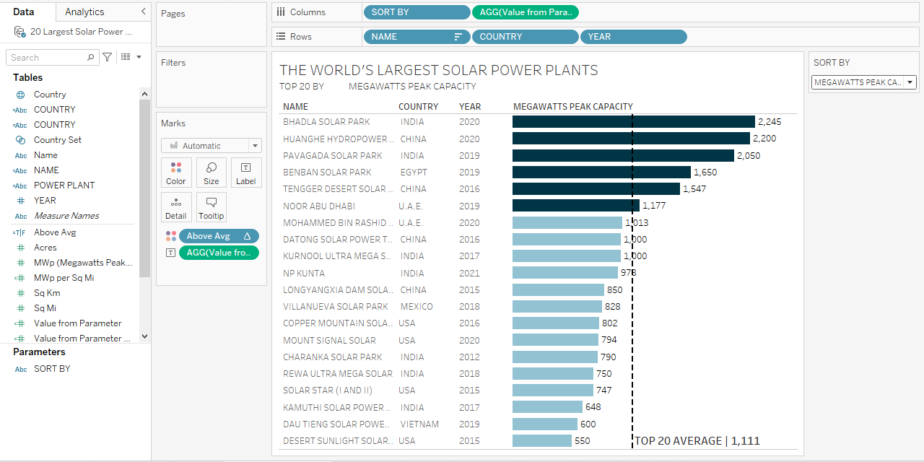
Megawatts Peak Capacity

Slide 10
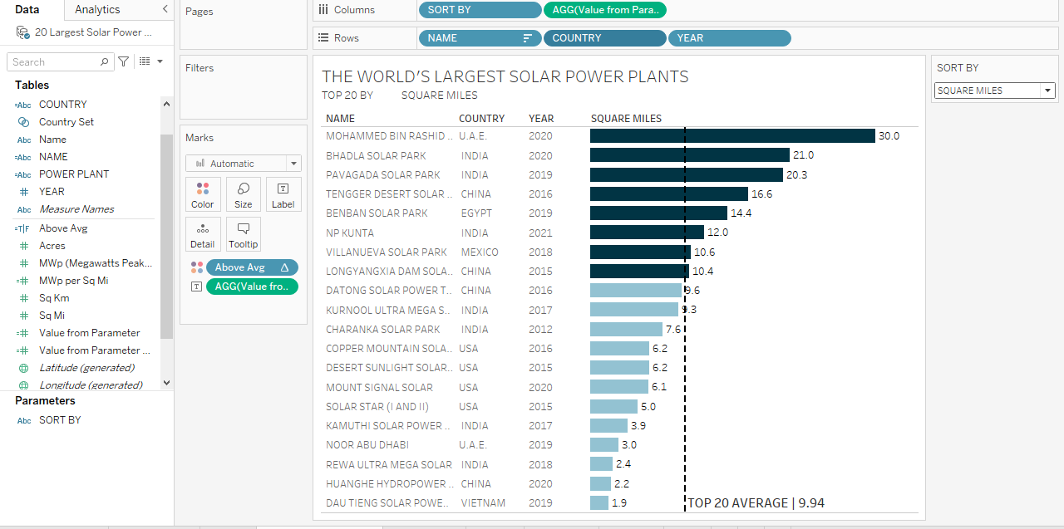
Square Miles

Slide 11
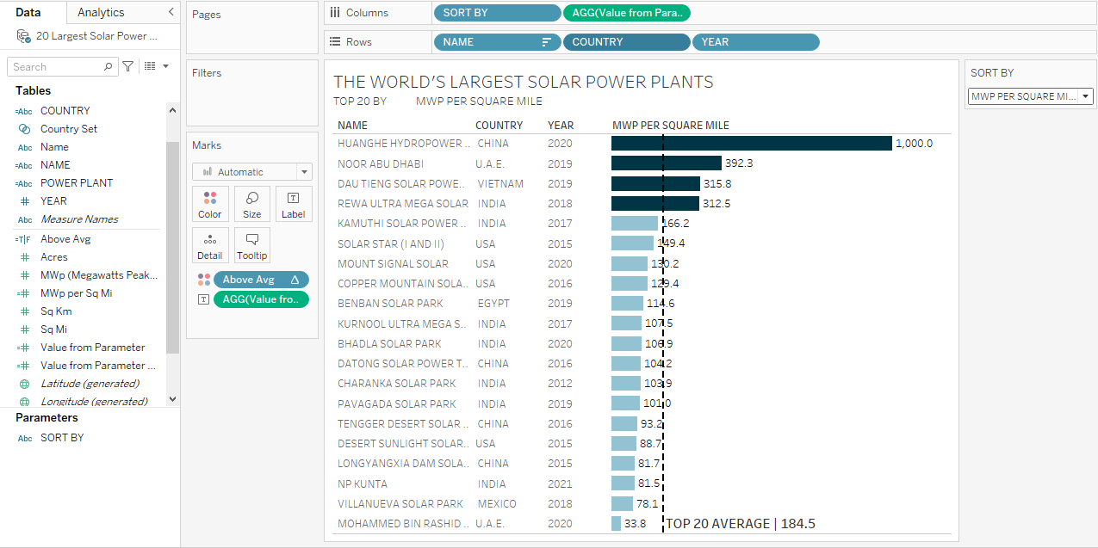
MWp Per Square Miles

Slide 12
Conclusion

Slide 13
THANK YOU

